Slide 1
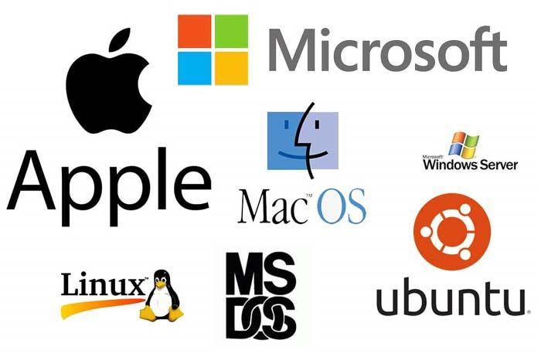

OPERATING SYSTEM
INSY 8223
Faculty of IT, GROUP D&F
Mr Uzayisenga Emmanuel / Dr Eric NIZEYIMANA / Mr Archimede IRAKOZE/ N. Gilbert
eric.nizeyimana@auca.ac.rw| +250 783 308 544, 0783219523(Gilbert)

Slide 2
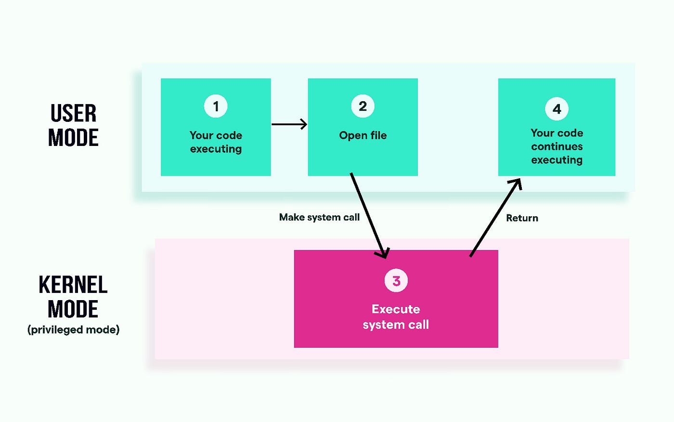
Lesson 2: System Calls and OS Security

Slide 3
Operating System Services
Key Services Provided by OS:
  Process Management – scheduling, execution, synchronization
  Memory Management – allocation, paging, swapping
  File System Management – creation, deletion, access control
  I/O Management – device drivers, buffering, spooling
  Security & Protection – user authentication, access control, encryption
  Networking & Communication – sockets, inter-process communication (IPC)
  User Interface – CLI, GUI

Slide 4
What is System calls
System calls are requests by a user-level program to the operating system's kernel to perform privileged operations or access system resources, serving as the interface between applications and the kernel.
System calls allow user-level programs to interact with the underlying operating system and hardware in a controlled and secure manner. They provide a standardized set of functions that abstract away the complexities of interacting with system resources, making it easier for developers to write portable and efficient code.

Slide 5
Cont’
A system call is a programmatic request from a program for a service from the operating system's kernel.
It acts as an interrupt that transfers control from user space to kernel space.
System calls are necessary because programs cannot directly access hardware or perform sensitive OS functions due to the protective boundaries set by the OS.

Slide 6
Example of System Call In Operating System
Some common examples of system calls include open(), read(), write(), fork(), exec(), exit(), and wait(), among others. Each system call has a specific purpose and allows processes to perform various tasks that require privileged access to system resources.
System Call Type | Windows Example | Unix Example
Process Control | Create Process(), Exit Process() | Fork(), exit()
File Management | Create File(), Read File() | open(), read()
Device Management | Set Console Mode(), Read Console() | Ioctl(), read()
Information Maintenance | Get Current Process ID(), Set Timer() | getpid(), alarm()
Communication | Create Pipe(), Create File Mapping() | Pipe(), shmget()

Slide 7
Types of System Calls
Process Control
File Management
Device Management
Information Maintenance
Communication
Security & Protection

Slide 8
1. Process Control
Purpose: Manage processes and their execution.
Examples:
  fork(), exec(), exit(), wait() (Linux/Unix)
  CreateProcess(), ExitProcess(), CreateThread() (Windows)
Services Provided:
  Create, terminate, suspend, resume processes
  Process synchronization and communication

Slide 9
2. File Management
Purpose: Create, access, and manage files and directories.
Examples:
  open(), read(), write(), close(), unlink() (Linux/Unix)
  CreateFile(), ReadFile(), WriteFile(), CloseHandle() (Windows)
Services Provided:
  Open/close files
  Read/write data
  Delete or rename files
  Control file attributes and permissions

Slide 10
3. Device Management
Purpose: Access and control hardware devices.
Examples:
  ioctl() (Linux/Unix)
  ReadFile(), WriteFile() on device handles (Windows)
Services Provided:
  Request/release devices
  Perform I/O operations
  Control device-specific settings

Slide 11
4. Information Maintenance
Purpose: Obtain system information or time.
Examples:
  getpid(), gettimeofday() (Linux/Unix)
  GetSystemTime(), GetCurrentProcessId() (Windows)
Services Provided:
  Retrieve process ID, system time, uptime
  Monitor system statistics

Slide 12
5. Communication
Purpose: Enable processes to communicate (Inter-Process Communication, IPC).
Examples:
  pipe(), shmget(), socket() (Linux/Unix)
  CreatePipe(), WSASocket() (Windows)
Services Provided:
  Message passing between processes
  Shared memory segments
  Network communication

Slide 13
6. Security & Protection
Purpose: Control access to resources and enforce protection policies.
Examples:
  chmod(), chown(), AccessCheck()
  LogonUser(), AccessCheck() (Windows)
Services Provided:
  Authentication and authorization
  Set file permissions
  Protect processes and memory

Slide 14
How System Calls Work
1. User Request:
  An application needs a service, such as writing to a file, which it cannot perform directly.
2. System Call Generation:
  The application makes a request through a high-level Application Programming Interface (API), often a library like POSIX. This function handles the low-level details and generates a system call.
3. Mode Switch:
  A system call triggers an interrupt that transfers the CPU from user mode to the privileged kernel mode, where the operating system's kernel resides.
4. Kernel Service:
  The kernel receives the request, executes the necessary privileged operation (e.g., opening a file), and retrieves or modifies the requested resource.
5. Control Return:
  Once the operation is complete, the kernel returns control back to the user-space application, switching the CPU back to user mode.

Slide 15
How Windows System Calls Work
Example: Opening a file with CreateFile()
User Program Request:
  Application calls CreateFile("C:\\data.txt", ...).
Win32 API:
  The request goes to the Win32 API (user mode).
Native API (ntdll.dll):
  Win32 API translates the request into a Native API call like NtCreateFile().
System Call Interface (Kernel Mode):
  The call crosses into kernel mode via a CPU instruction (syscall).
Windows Kernel:
  The kernel’s I/O manager handles the request.
  It communicates with the filesystem driver to open the file.
Return to User Program:
  A file handle is returned to the application.

Slide 16
Example: Reading a file using read() in Linux
User Program Request:
      read(fd, buffer, size);
  Application calls read() function from C standard library.
Library to System Call Interface:
  The library wraps the request and triggers a software interrupt (trap) to switch from user mode → kernel mode.
Kernel Execution:
  The kernel checks if the file descriptor fd is valid.
  Reads the requested bytes from storage into memory.
Return to User Space:
  Kernel copies data into buffer in user space.
  Control returns to the program.

Slide 17
Why System Calls are Necessary
Protection:
  They prevent user programs from directly accessing and corrupting sensitive system resources or hardware.
Abstraction:
  They provide a consistent, high-level programming interface to developers, abstracting away the complex underlying hardware.
Portability:
  Using libraries that wrap system calls makes it easier to develop applications that can run on different operating systems.

Slide 18
Execution Flow of a System Call
User program invokes API function → library wrapper.
Library prepares parameters (registers, stack, or memory block).
Trap instruction signals kernel.
Kernel verifies parameters, executes service.
Result/status returned to user program.

Slide 19
System calls vs library function
Feature | System Call | Library Function
Definition | A request made by a program to the operating system kernel to perform a service. | A pre-written function in a programming library that simplifies tasks for the programmer.
Mode of Execution | Executes in kernel mode (protected mode). | Executes in user mode.

Slide 20
By Purpose
System Call: Access hardware or OS resources safely.
  Examples: file operations, process control, device access.
Library Function: Provides convenience functions or wrappers around system calls.
  Examples: printf(), scanf(), fopen().

Slide 21
Relationship
Library functions often call system calls internally.
  Example (C program): printf("Hello World\n");
Printf() is a library function
Internally, it may use the write() system call to output to the console.

Slide 22
Performance
Aspect | System Call | Library Function
Speed | Slower (switches from user → kernel mode) | Faster (runs in user mode)
Overhead | High due to context switching | Low

Slide 23
Examples
Task | Library Function | System Call
Read file | fread() | read()
Write file | fwrite() | write()
Open file | fopen() | open()
Memory allocation | malloc() | brk() / mmap() (Linux system calls)

Slide 24
Operating System Security
Principles
Mechanisms
Threats

Slide 25
Introduction to OS Security
OS Security ensures the confidentiality, integrity, and availability of data and resources.
Protects hardware, software, and user data from unauthorized access or misuse.
Key Goal: Provide a trusted computing environment.

Slide 26
Importance of OS Security
Prevents data theft and corruption.
Maintains system reliability and uptime.
Ensures user accountability.
Supports secure execution of applications.

Slide 27
Security Principles – The CIA Triad
Confidentiality: Data accessible only to authorized users.
Integrity: Data and system remain accurate and unaltered.
Availability: Resources are accessible when needed.
Example: Banking software must protect account data (confidentiality), prevent unauthorized changes (integrity), and remain available for transactions.

Slide 28
Threats to OS Security
Malware: Viruses, worms, trojans
Unauthorized Access: Hackers exploiting weak passwords or vulnerabilities
Privilege Escalation: Normal users gaining admin rights
Denial of Service (DoS): Making system unavailable
Data Breaches: Leaking sensitive data

Slide 29
Security Mechanisms Overview
OS uses mechanisms to prevent and detect attacks.
Key mechanisms include:
  Authentication
  Authorization / Access Control
  Encryption
  Auditing & Logging
  Isolation & Sandboxing

Slide 30
Authentication
Verifies user identity before granting access.
Methods:
  Passwords / PINs
  Biometrics (fingerprint, facial recognition)
  Multi-Factor Authentication (MFA)
Example: Windows login, Linux PAM authentication

Slide 31
Access Control
Determines what authenticated users can do.
Types of Access Control:
  Discretionary Access Control (DAC): Owner controls access
  Mandatory Access Control (MAC): Central authority controls access
  Role-Based Access Control (RBAC): Permissions based on roles
Example: File permissions in Linux (chmod, chown)

Slide 32
File System Security
Protects files from unauthorized access.
Methods:
  File permissions (read, write, execute)
  File ownership
  Encryption (BitLocker in Windows, LUKS in Linux)
Example: Only admin can modify system configuration files.

Slide 33
Memory and Process Security
Memory Protection: Prevents processes from accessing each other’s memory.
Techniques:
  Base and limit registers
  Paging and segmentation
Process Isolation: Each process runs in its own protected space.

Slide 34
Device and I/O Security
Devices like printers, disks, and network cards are protected.
Mechanisms:
  Privileged instructions for kernel-only access
  Device drivers enforce security policies
Example: Only OS can write to hardware buffers directly.

Slide 35
Network Security in OS
Protects against network-based attacks.
OS-level features:
  Firewalls
  Secure socket layer (SSL/TLS) support
  Intrusion detection
Example: Windows Defender Firewall, Linux iptables

Slide 36
Auditing and Logging
Monitors user and system activity.
Detects suspicious behavior.
Tools:
  auditd in Linux
  Event Viewer in Windows
Example: Failed login attempts can trigger alerts.

Slide 37
Virtualization and Sandboxing
Virtual Machines (VMs): Isolate OS instances for security.
Containers (Docker): Lightweight process isolation.
Sandboxing: Applications run in restricted environments.
Benefit: Reduces the impact of malware or compromised apps.

Slide 38
Virtualization Concepts
Running multiple OS instances on one physical machine using a hypervisor.
Types:
  Full Virtualization (VMware, VirtualBox)
  Para-Virtualization (Xen)
  Hardware-Assisted (Intel VT-x, AMD-V)
Benefits: Better resource utilization, isolation, flexibility, test environments.

Slide 39
Cloud OS Concepts
Cloud Operating System: Provides OS-like services on cloud platforms.
Examples: OpenStack, Google App Engine, Microsoft Azure.
Functions:
  Virtual machine provisioning
  Resource scheduling
  Security & authentication
  Storage and networking services
Trend: Containers (Docker, Kubernetes) are replacing full OS virtualization.

Slide 40
Lesson 3. Process Management

Slide 41

Thank you
For I know the thoughts that I think toward you, saith the LORD, thoughts of peace, and not of evil, to give you an expected end. Jeremy 29:11

